Slide 1
Ksc6103 DATA STRUCTURE & ALGORITHM
GRAPH

Slide 2
CHAPTER CONTENT
Introduction of Graph
Data structure of Graph
Adjacency list structure
Adjacency Matrix Structure
Type of graph
Undirected
directed
Weighted
Graph Algorithm
Graph Traversal Algorithm
Transitive Closure
Directed Acyclic Graph
Shortest Paths
Minimum Spanning Trees

Slide 3



CHAPTER LEARNING OUTCOMES
 | Understand the concepts of Graph and its representation.
 | Explain several graph traversals algorithm.
 | Explain the concepts of shortest path algorithm and minimum spanning tree.

Slide 4
Introduction

Slide 5
Graphs
A Graph is a non-linear data structure consisting of nodes and edges.
A graph G = (V,E) is composed of:
V: set of vertices.
E: set of edges connecting the vertices in V
Nodes/Vertices: Nodes are entities whose relationships are expressed using edges. If a graph comprises 2 nodes and an undirected edge between them, then it expresses a bi-directional relationship between the nodes and edge.
Edges: Edges are the components that are used to represent the relationships between various nodes in a graph. An edge between two nodes expresses a one-way or two-way relationship between the nodes.
An edge e = (u,v) is a pair of vertices.

Slide 6
Application
Google maps uses graphs for building transportation systems, where intersection of two(or more) roads are a vertex and the road connecting two vertices is an edge, thus their navigation system is based on the algorithm to calculate the shortest path between two vertices.
In Facebook, users are the vertices and if they are friends then there is an edge running between them. Facebook’s Friend suggestion algorithm uses graph theory. Facebook is an example of undirected graph.
In World Wide Web, web pages are the vertices. There is an edge from a page u to other page v if there is a link of page v on page u. This is an example of Directed graph. It was the basic idea behind Google Page Ranking Algorithm.
In Operating System, we come across the Resource Allocation Graph where each process and resources are vertices. Edges are drawn from resources to the allocated process, or from requesting process to the requested resource. If this leads to any formation of a cycle, then a deadlock will occur.

Slide 7
DATA STRUCTURE OF GRAPH

Slide 8
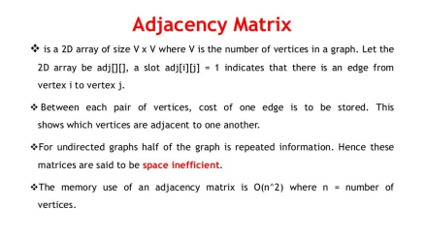
Adjacency Matrix
Is a 2D of size V x V where V is the number of vertices in a graph. Let the 2D array be adj[][], a slot adj[i][j] = 1 indicates that there is an edge from vertex I to vertex j.
Between each pair of vertices, cost of one edge is to be stored. This shows which vertices are adjacent to one another.
For undirected graphs half of the graph is repeated information. Hence these matrices are said to be space inefficient.
The memory use of an adjacency matrix is O(n^2) where n = number of vertices

Slide 9
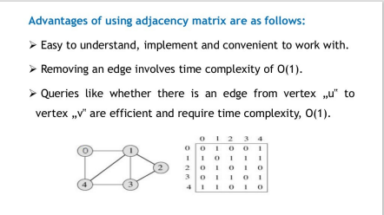

Slide 10
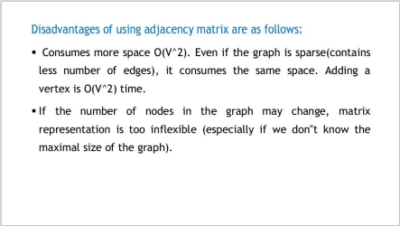

Slide 11
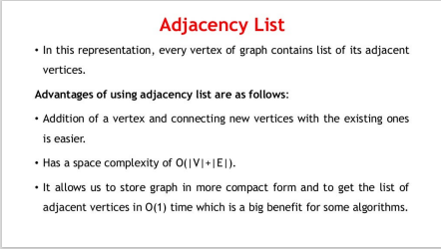

Slide 12
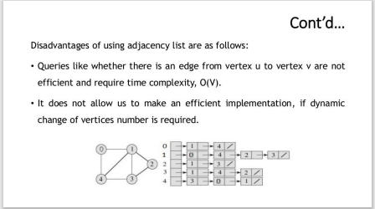

Slide 13
Type of graph

Slide 14
Type of Graph
Undirected Graph all edges are undirected or if the connection is symmetric (in other words A is connected to B <---> B is connected to A), then we say the graph is undirected.
Directed Graph all edges are directed or If an edge only implies one direction of connection, we say the graph is directed.
Weighted graph: A weighted graph is a graph where each edge has associated numerical value, called weight.

Slide 15
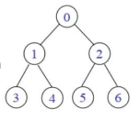
Undirected Graphs
The pair of vertices representing any edge in unordered. Thus, the pairs (u,v) and (v,u) represent the same edge
Example: a graph G2
V(G2)={0,1,2,3,4,5,6}
E(G2)={(0,1),(0,2),(1,3),(1,4),(2,5),(2,6)}
G2 is also a tree that is a special case of graph
An undirected graph is said to be connected if there is a path between every pair of vertices in the graph.

Slide 16
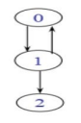
Directed Graphs (Digraph)
Each edge is represented by a ordered pair <u,v>
Example: a graph G3
V(G3)={0,1,2}
E(G3)={<0,1>,<1,0>,<1,2>}
A directed path is a directed graph G is a sequence of distinct vertices, such that there is an edge from each vertex in the sequence to the next.

Slide 17
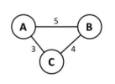
Weight Graph
A weighted graph is a graph where each edge has an associated numerical value, called weight. Weighted graphs may be either directed or undirected. The weight of the edge is often referred to as the “cost” of the edge. Example of weighted graph is:

Slide 18
Graph algorithm

Slide 19
Graph Traversal Algorithm
Graph traversal means visiting all the nodes of the graph.
We want to visit every vertex and every edge exactly once in some well-defined order.
There are two primary traversal algorithm:
Breadth-First Search (BFS) and
Depth-First Search (DFS).

Slide 20
DFS/BFS Search Algorithm
Search (Node n):
Visit n.
Put n’s children on a list (Stack or Queue).
For each child c in list:
SEARCH(c)
If we use a Stack and recursive, we get DFS
If we use a Queue and iterative, we get BFS

Slide 21
BFS-Breadth First Search
Idea: Visit all children before first grandchild.
Visiting order: Visit a vertex, then visit all of its neighbors, then visit all of the neighbors of its neighbors,…
BFS is that a BFS is best used at finding the shortest paths in a given Graph
Needs flags or someway to preventing infinite loops: Weakness

Slide 22
BFS Algorithm (Pseudocode)
create a queue Q
mark v as visited and put v into Q
while Q is non-empty
remove the head u of Q
mark and enqueuer all (unvisited) neighbours of u

Slide 23
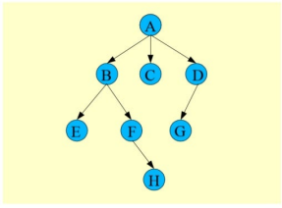
Example: BFS

Slide 24
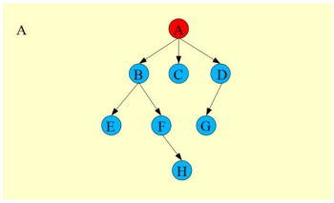
Example: BFS (Cont’d)

Slide 25
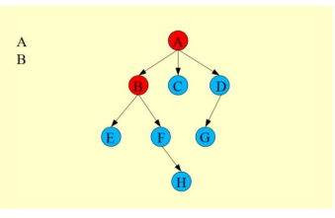
Example: BFS (Cont’d)

Slide 26
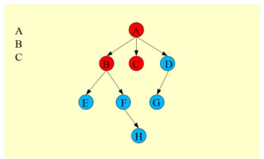
Example: BFS (Cont’d)

Slide 27
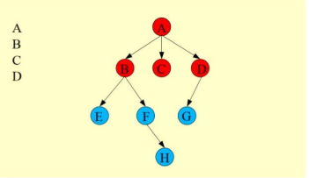
Example: BFS (Cont’d)

Slide 28
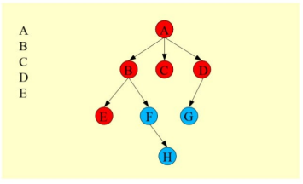
Example: BFS (Cont’d)

Slide 29
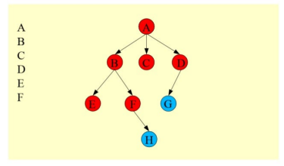
Example: BFS (Cont’d)

Slide 30
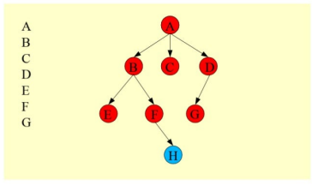
Example: BFS (Cont’d)

Slide 31
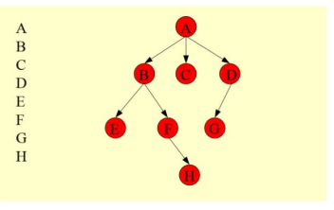
Example: BFS (Cont’d)

Slide 32
DFS-Depth First Search
Idea: Follow a single path to its end, then backtrack
Is an algorithm for traversing or searching a tree, tree structure or graph
One starts at the root (selecting some node as the root in the graph case) and explores as far as possible along each branch before backtracking.
DFS Algorithm using stack

Slide 33
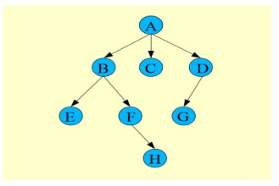
Example: DFS

Slide 34
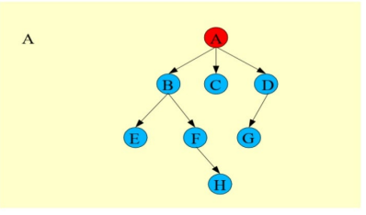
Example: DFS (Cont’d)

Slide 35
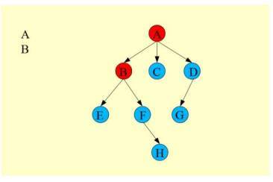
Example: DFS (Cont’d)

Slide 36
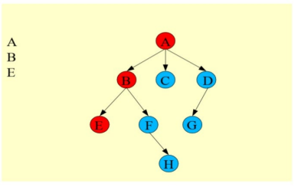
Example: DFS (Cont’d)

Slide 37
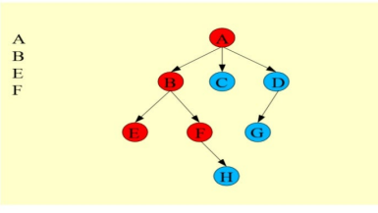
Example: DFS (Cont’d)

Slide 38
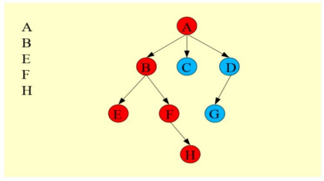
Example: DFS (Cont’d)

Slide 39
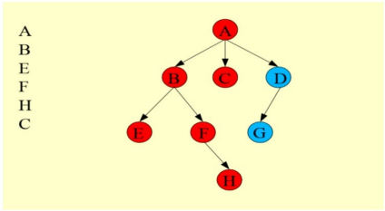
Example: DFS (Cont’d)

Slide 40
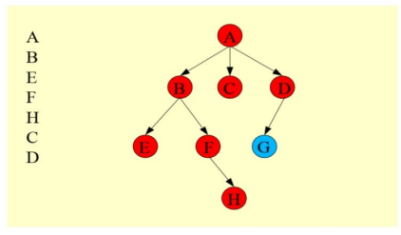
Example: DFS (Cont’d)

Slide 41
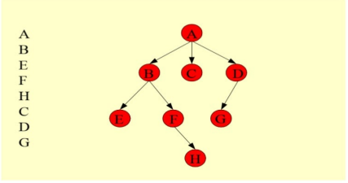
Example: DFS (Cont’d)

Slide 42
Graph Traversal Algorithm Complexity
BFS vs DFS Time complexity : O(V+E), when implemented using the adjacency list. Where V is number of vertices in the graph and E is number of edges in the graph.
Space complexity (memory)
BFS : Space complexity is O(|V|) as well – since at worst case you need to hold all vertices in the queue.
DFS: Space complexity depends on the implementation, a recursive implementation can have a O(h) space complexity [worst case], where h is the maximal depth of your tree. But Depth-first can waste time going down a “rabbit hole”, when solution is high in tree.
Worst Case for DFS will be the best case for BFS, and the Best Case for DFS will be the worst case for BFS.

Slide 43
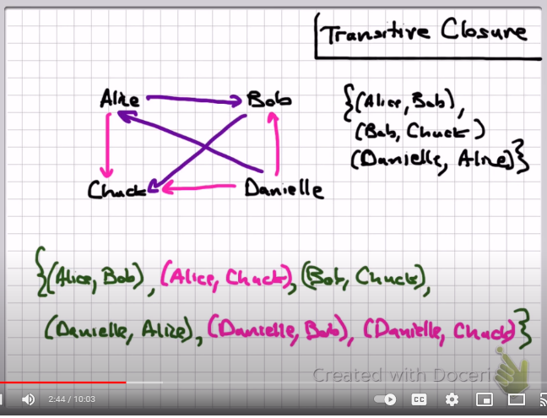
Transitive closure
https://www.geeksforgeeks.org/transitive-closure-of-a-graph/
An extension or superset of a binary relation such that whenever (a,b) and (b,c) are in the extension, (a,c) is also in the extension.

Slide 44
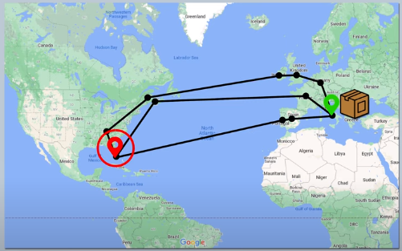
Directed Acyclic Graph
https://mungingdata.com/python/dag-directed-acyclic-graph-networkx/
A directed acyclic graph is a directed graph that has no cycles.

Slide 45
Shortest path
https://mungingdata.com/python/dag-directed-acyclic-graph-networkx/
https://youtu.be/pVfj6mxhdMw

Slide 46
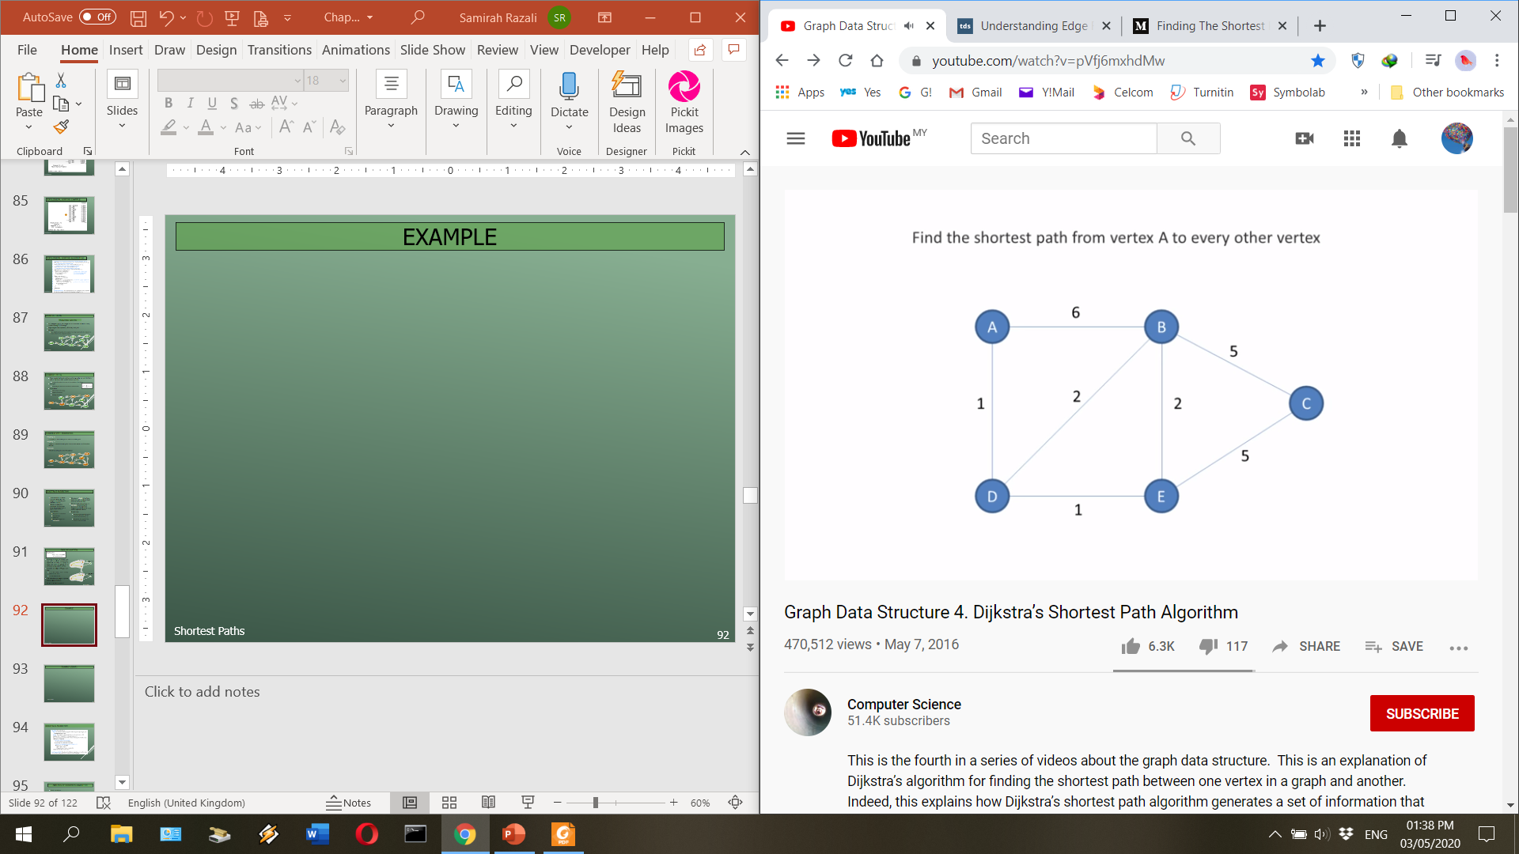
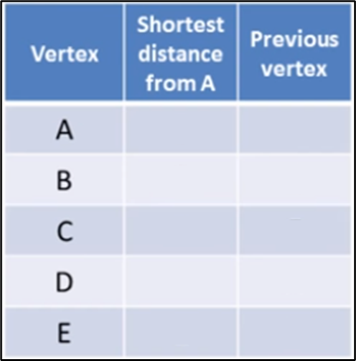
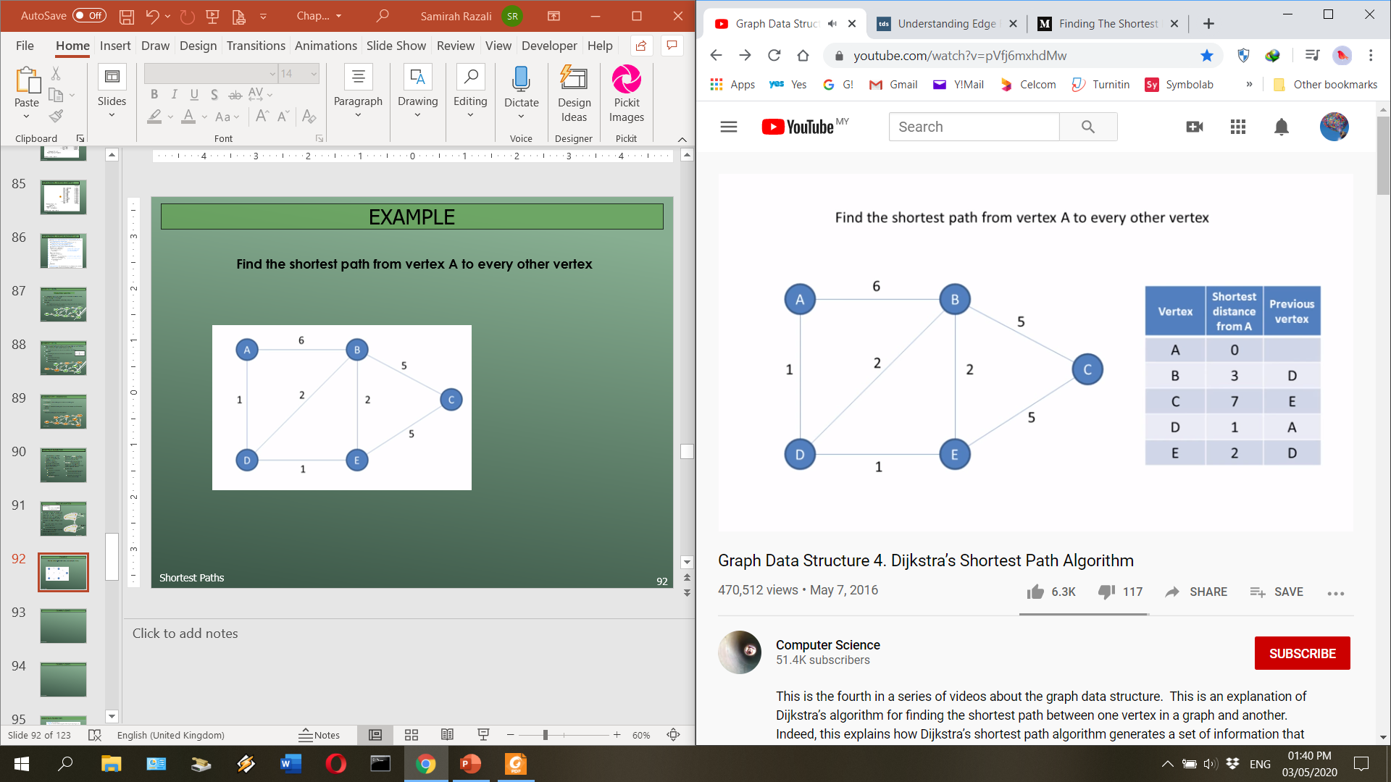
Example
Find the shortest path from vertex A to every other vertex

Slide 47
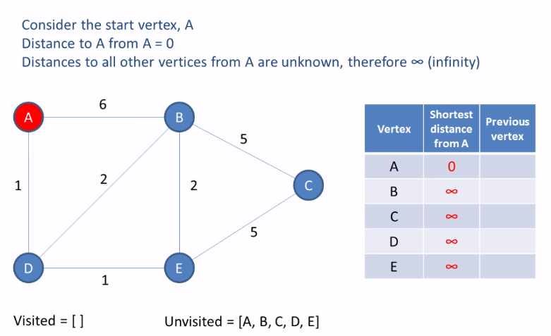
Example
Find the shortest path from vertex A to every other vertex

Slide 48
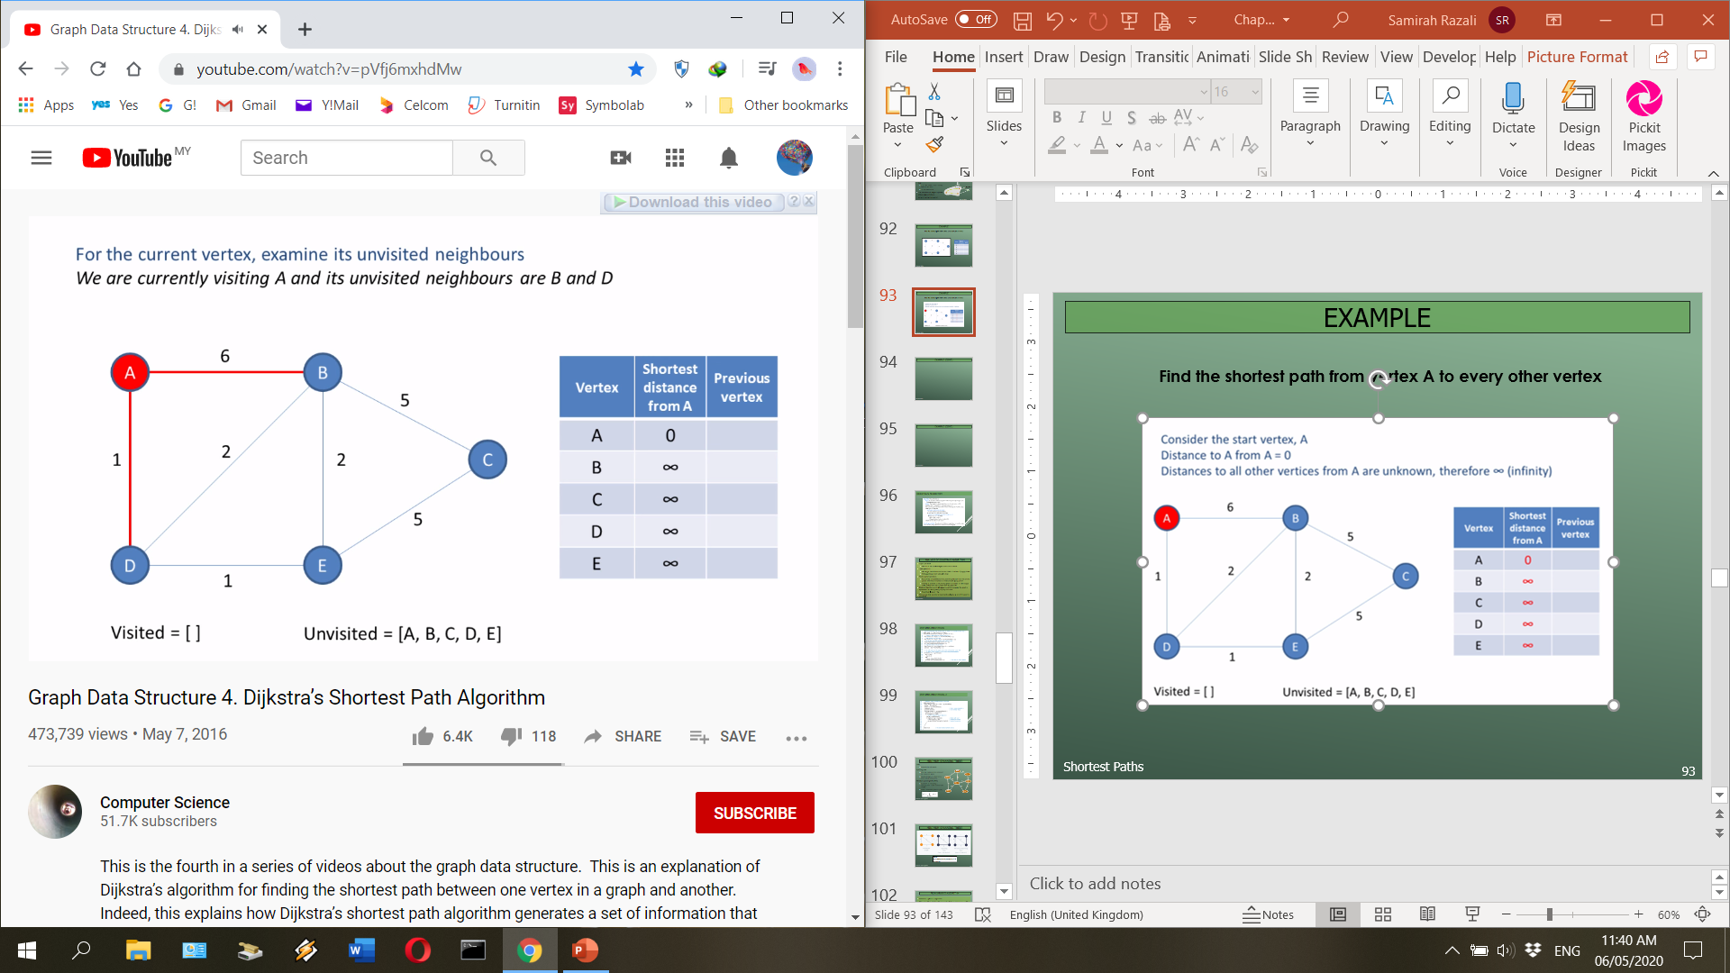
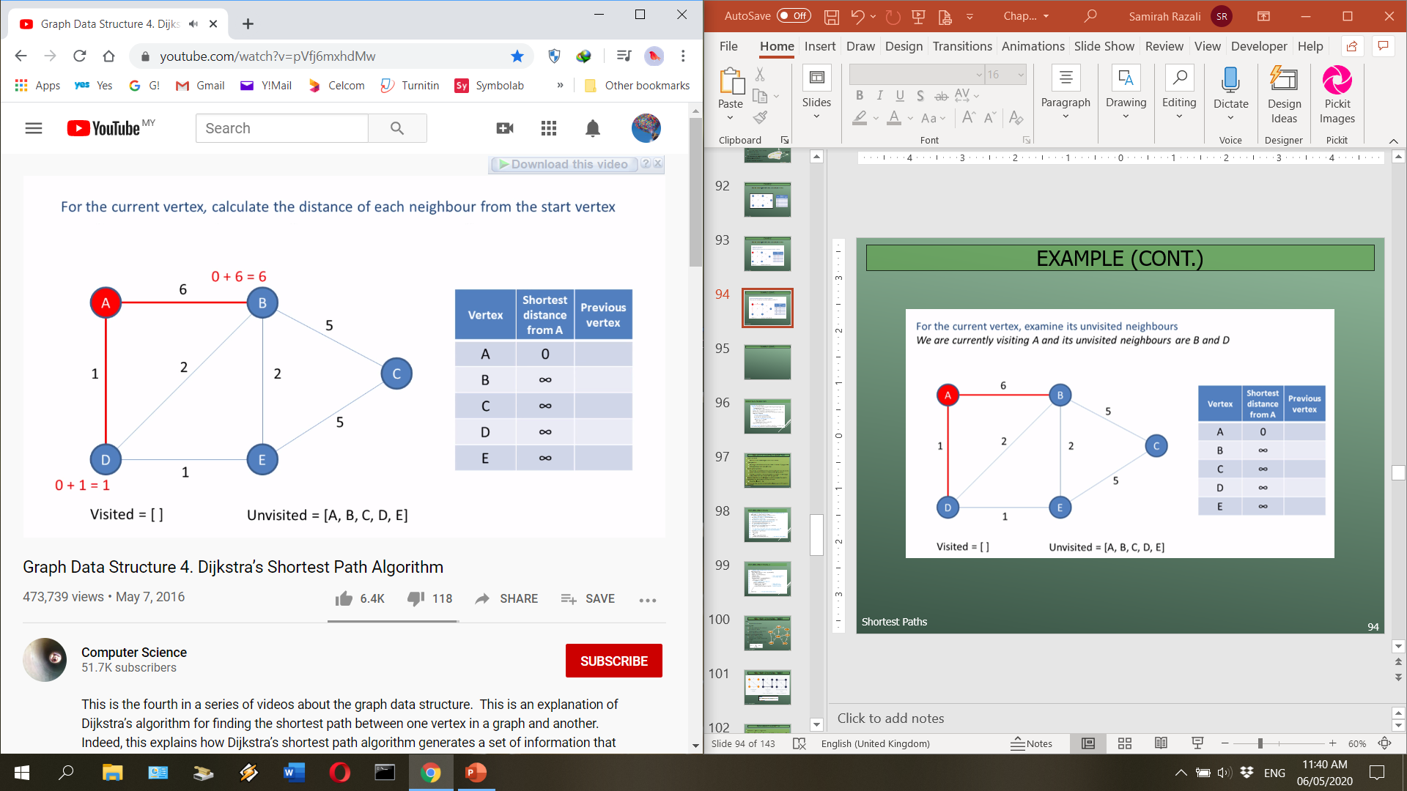
Example (cont.)

Slide 49
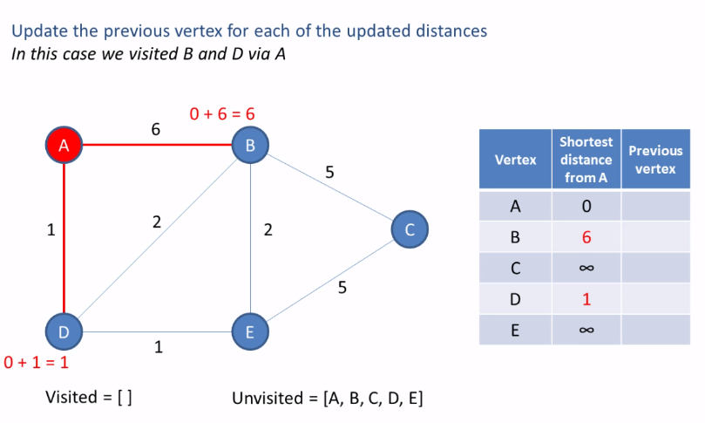
Example (cont.)

Slide 50
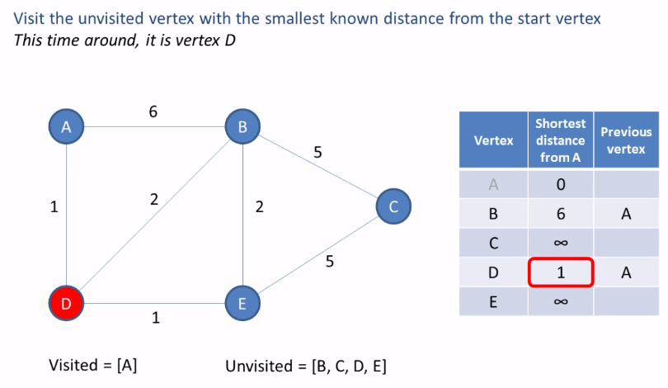
Example (cont.)

Slide 51
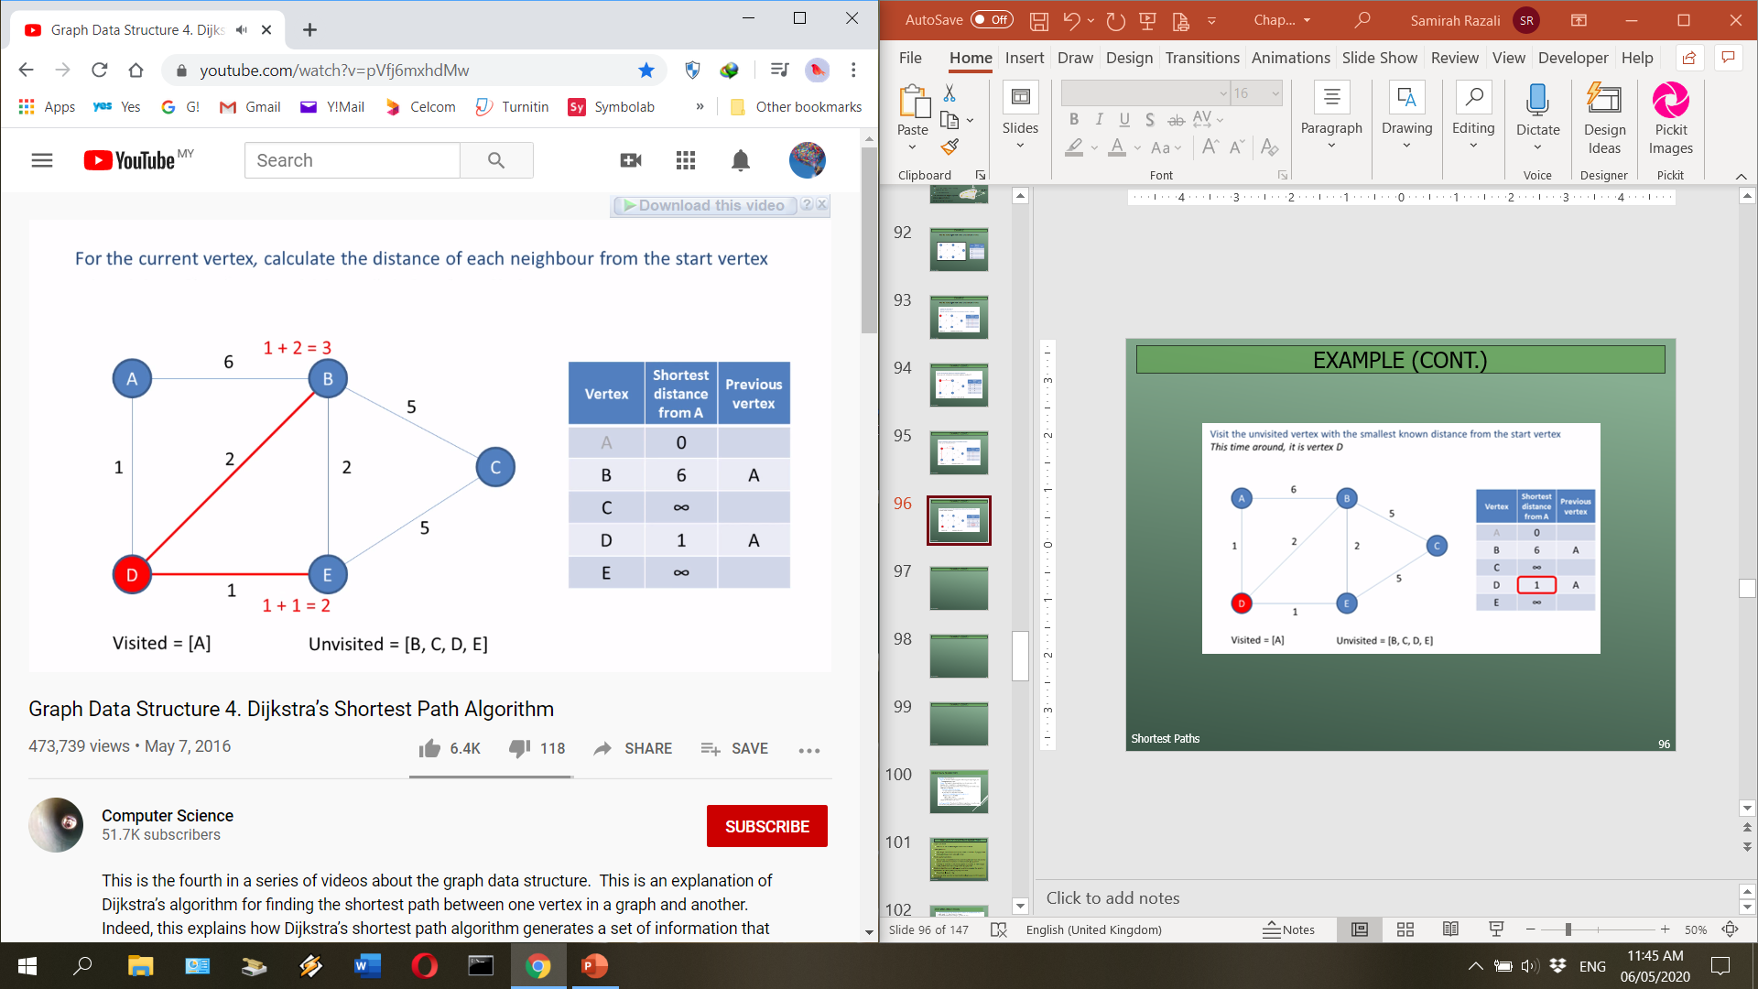
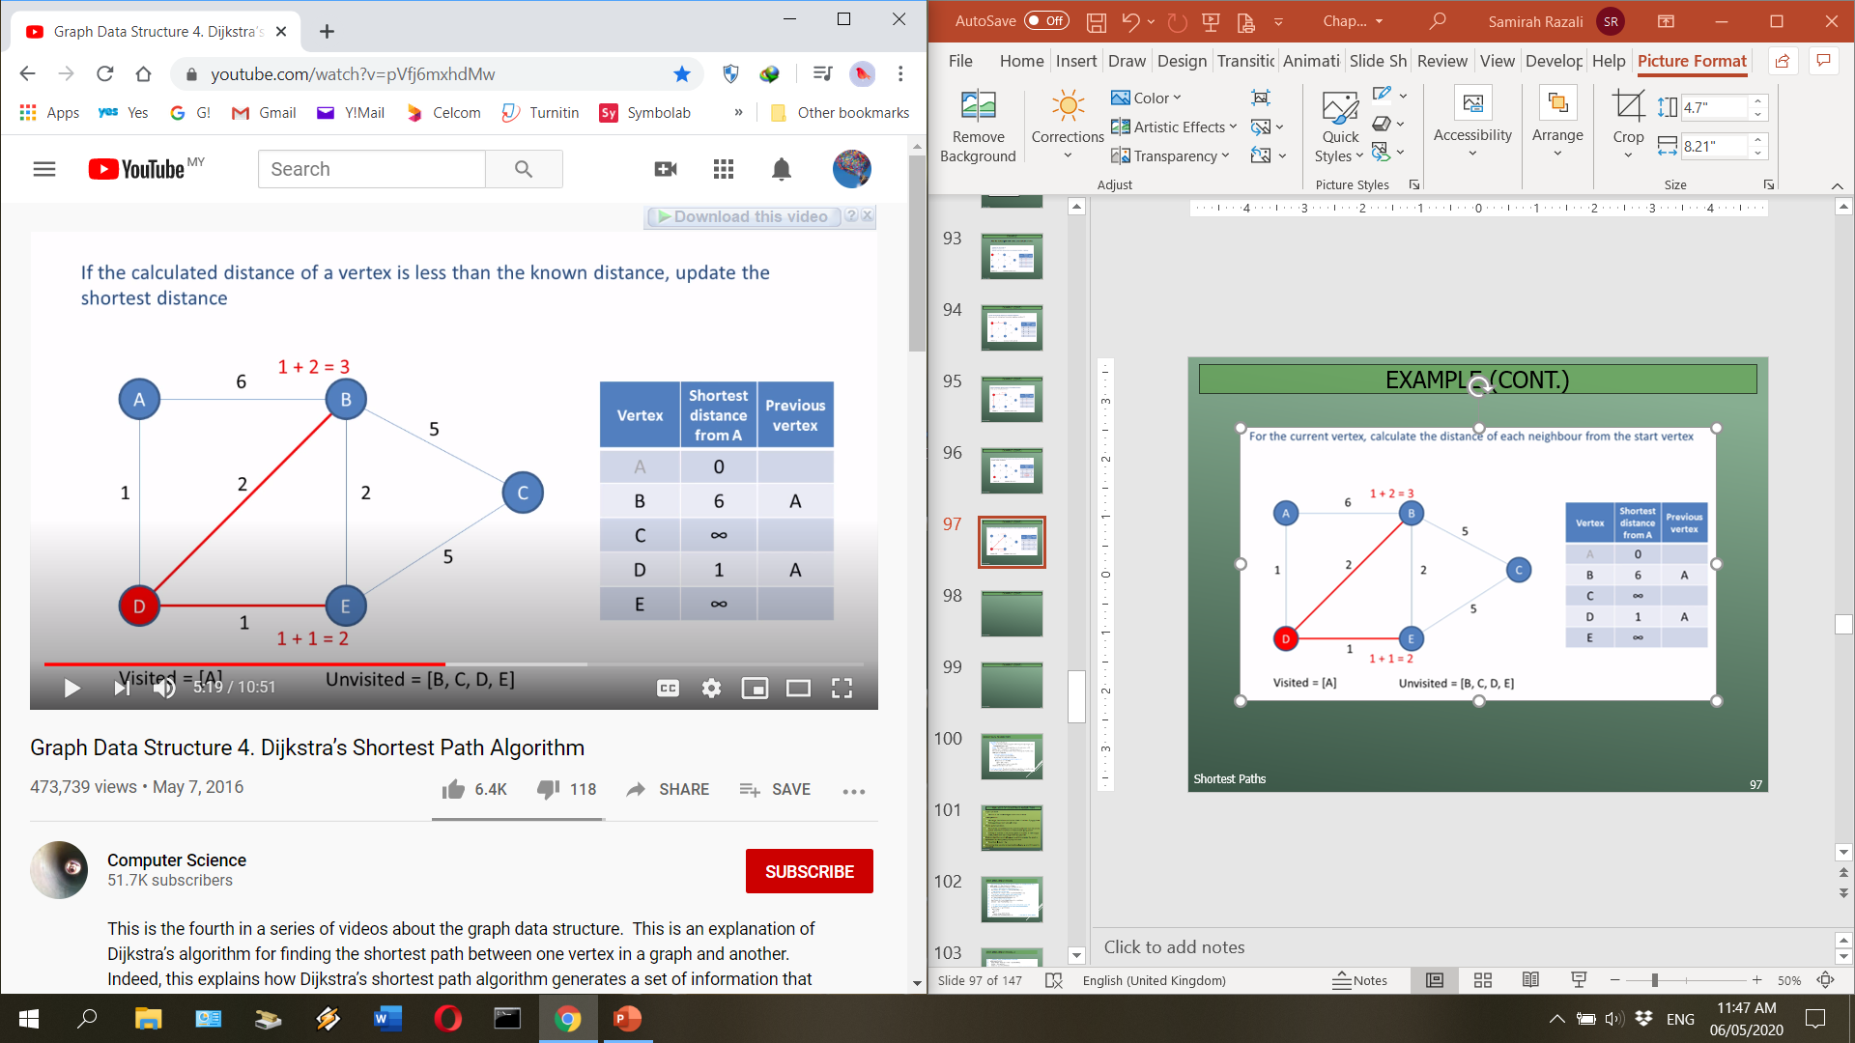
Example (cont.)

Slide 52
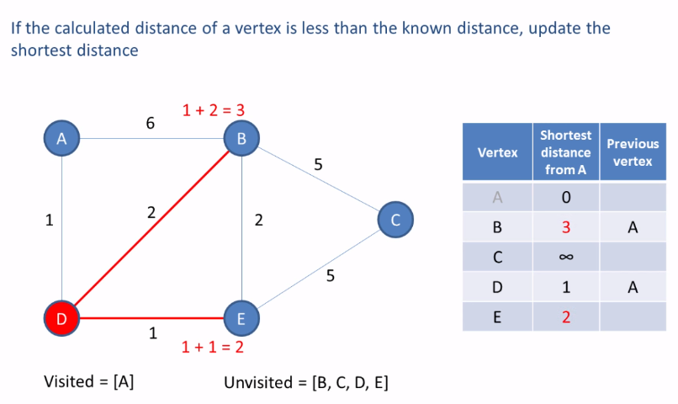
Example (cont.)

Slide 53
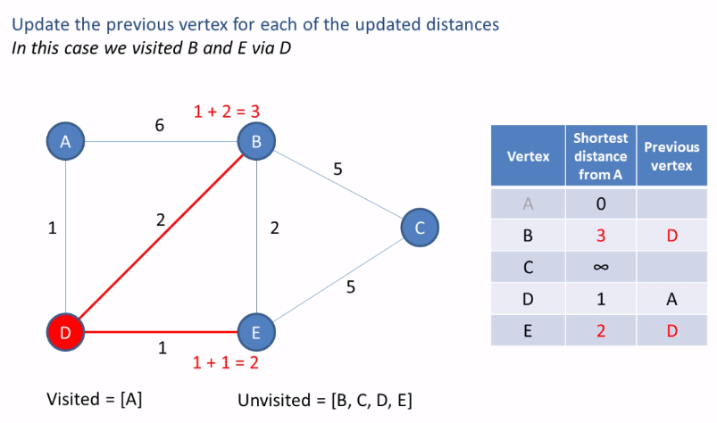
Example (cont.)

Slide 54
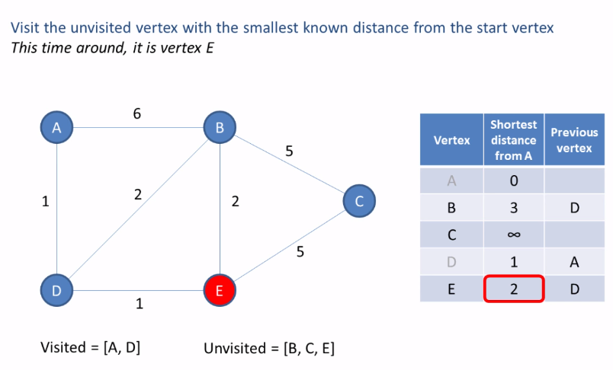
Example (cont.)

Slide 55
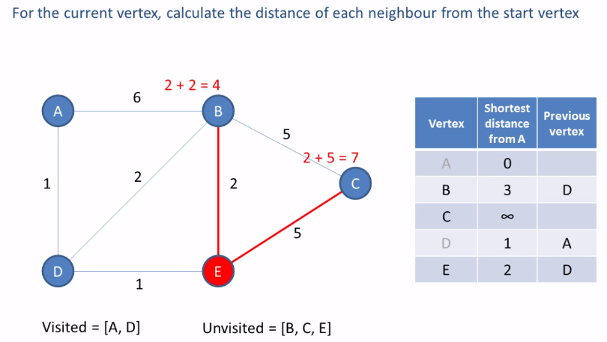
Example (cont.)

Slide 56
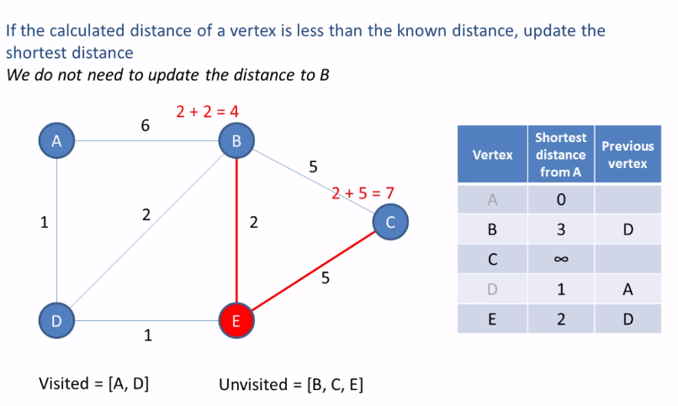
Example (cont.)

Slide 57
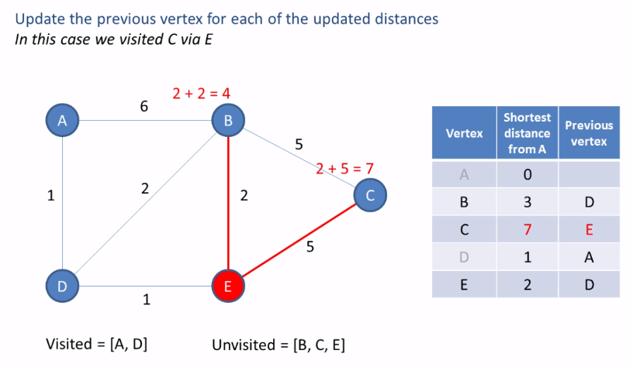
Example (cont.)

Slide 58
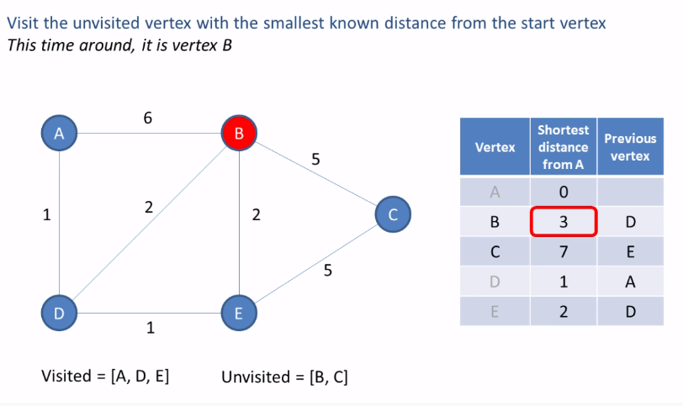
Example (cont.)

Slide 59

Example (cont.)

Slide 60

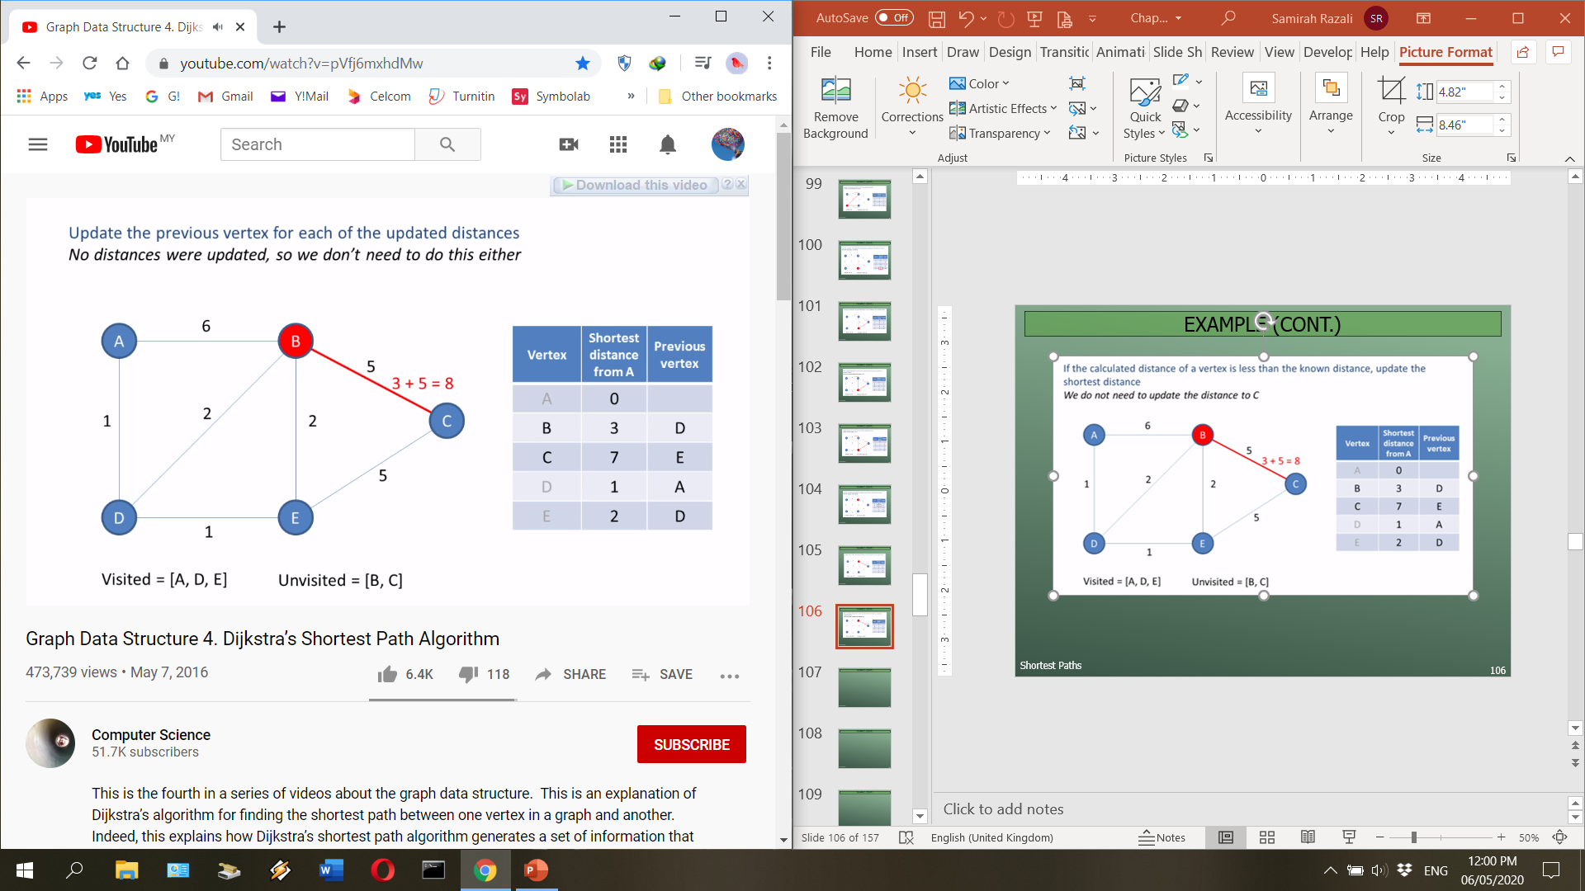
Example (cont.)

Slide 61
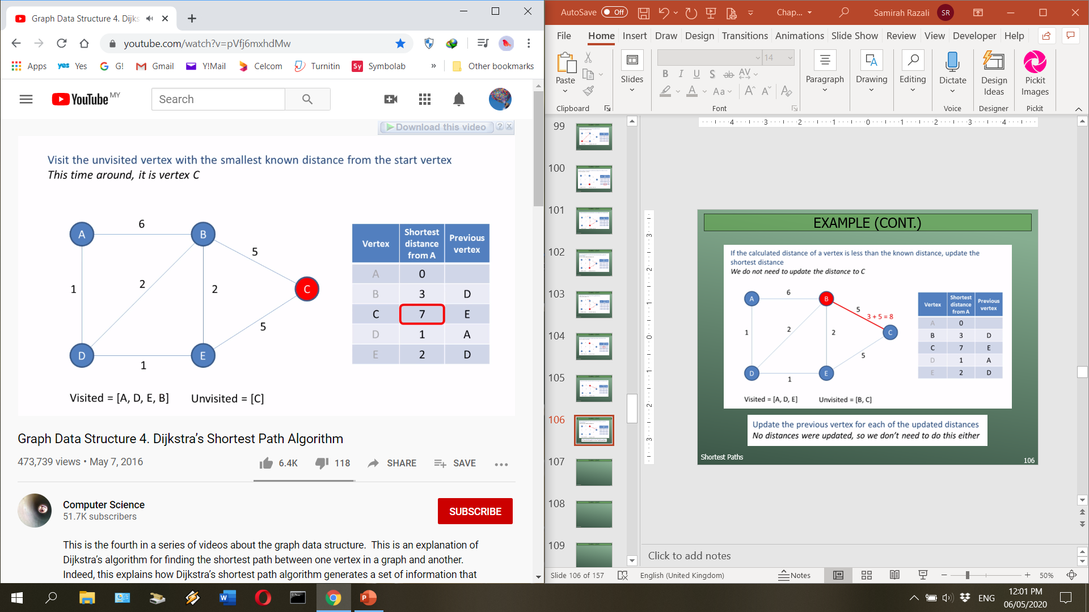

Example (cont.)

Slide 62
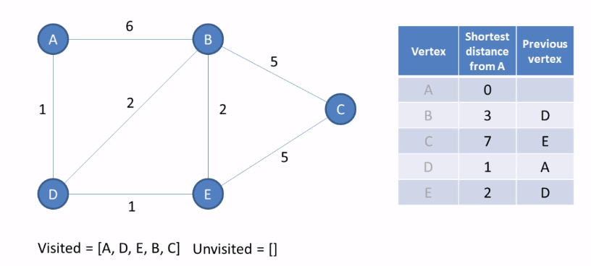
Example (cont.)

Slide 63
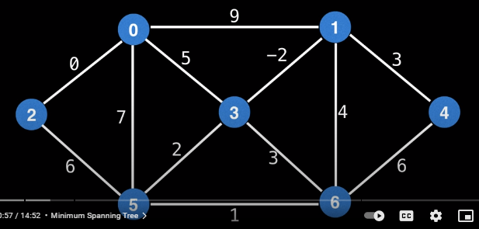
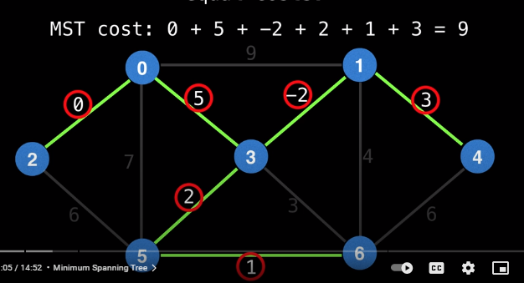
Minimum Spanning Trees
https://mungingdata.com/python/dag-directed-acyclic-graph-networkx/
A minimum spanning tree (MST) or minimum weight spanning tree is a subset of the edges of a connected, edge-weighted undirected graph that connects all the vertices together, without any cycles and with the minimum possible total edge weight.

